Slide 1
Creating Hybrid images
Group 3

Slide 2
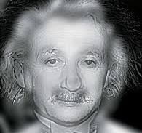
Introduction
Hybrid images are a technique that produces static images with two interpretations.
This combines low spatial frequencies of one image with the high spatial frequencies of another image in creating an image that changes interpretation with viewing distance.

Slide 3
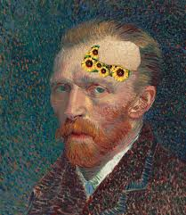
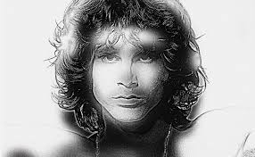
Application
Artistic image interpretation
https://www.grapheine.com/en/graphic-design-en/art-science-of-hybrid-images

Slide 4
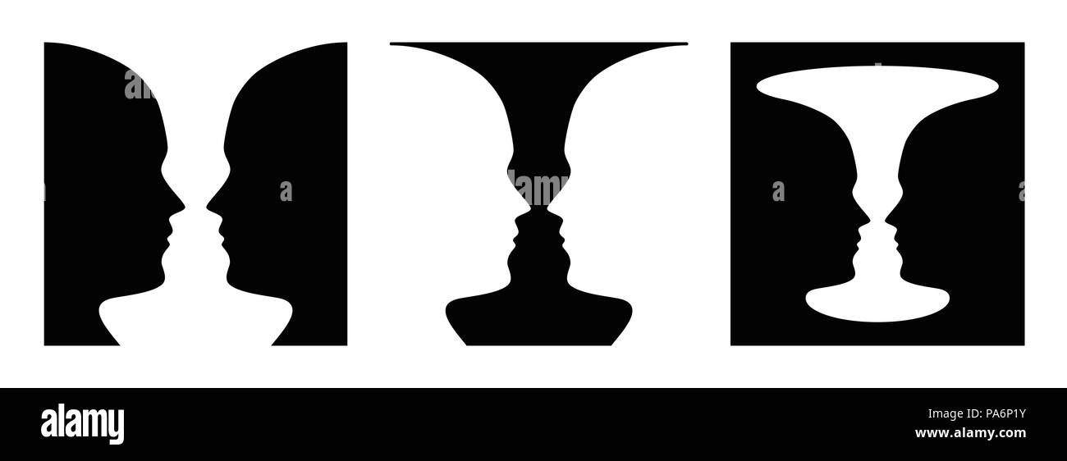
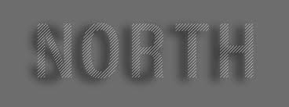
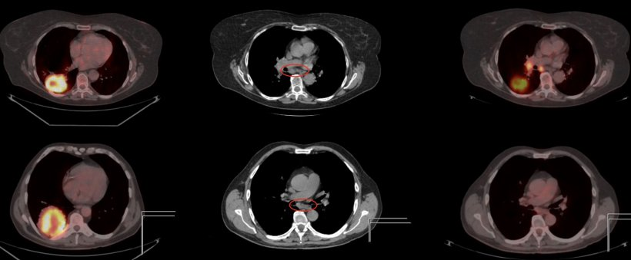
Application
Psychology and perception study
Steganography
Medical imaging

Slide 5
Dataset
For this project, pairs of images were used to be combined to make hybrid images.
Images were selected where each pair had similar content, ensuring they blended very well together.
https://www.kaggle.com/datasets/prasoonkottarathil/face-mask-lite-dataset

Slide 6
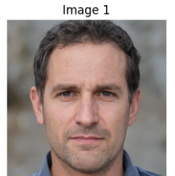
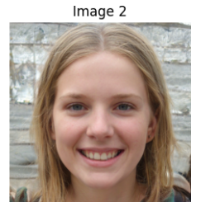
Methodology
Image Selection -
One image provides the overall shape (low-frequency content)
The other provides fine details (high-frequency content)

Slide 7
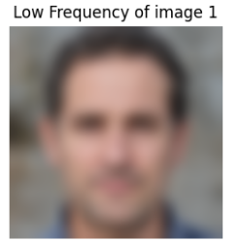
Methodology
Applying Low-Pass Filters-
Low-pass filters blur the image, keeping only the broad shapes and forms.
We used Gaussian, Median, Average Filters to blur the image.

Slide 8
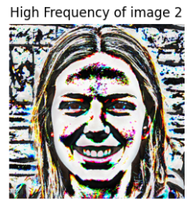
Methodology
Applying high pass filters-
High-pass filters emphasize fine details and edges.
The second image is also blurred using the same Gaussian filter.
The high-frequency components are extracted by subtracting the blurred image from the original image.

Slide 9
Methodology
Combining Filtered images-
Combined the low-pass filtered image with the high-pass filtered image to create the hybrid image.
Simple Addition: Adds the pixel values of the two images
hybrid_image = low_frequencies + high_frequencies

Slide 10
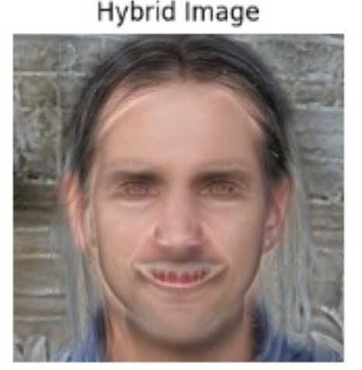
Result
The result is an image that can appear to be one thing up close (dominated by high frequencies) and another thing from a distance (dominated by low frequencies).

Slide 11
Discussion
Best low-pass filter
We used different low pass filters
Averaging Filter: This blurs the image by averaging the pixel values.
Gaussian Filter: This blurs the image using a Gaussian function
Median Filter: This reduces noise by taking the median of the pixel values

Slide 12
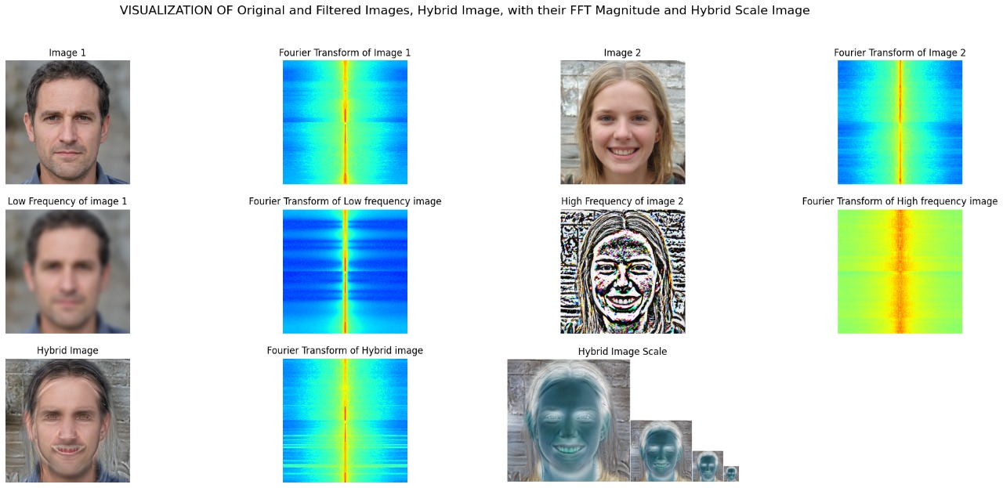
Gaussian filter

Slide 13
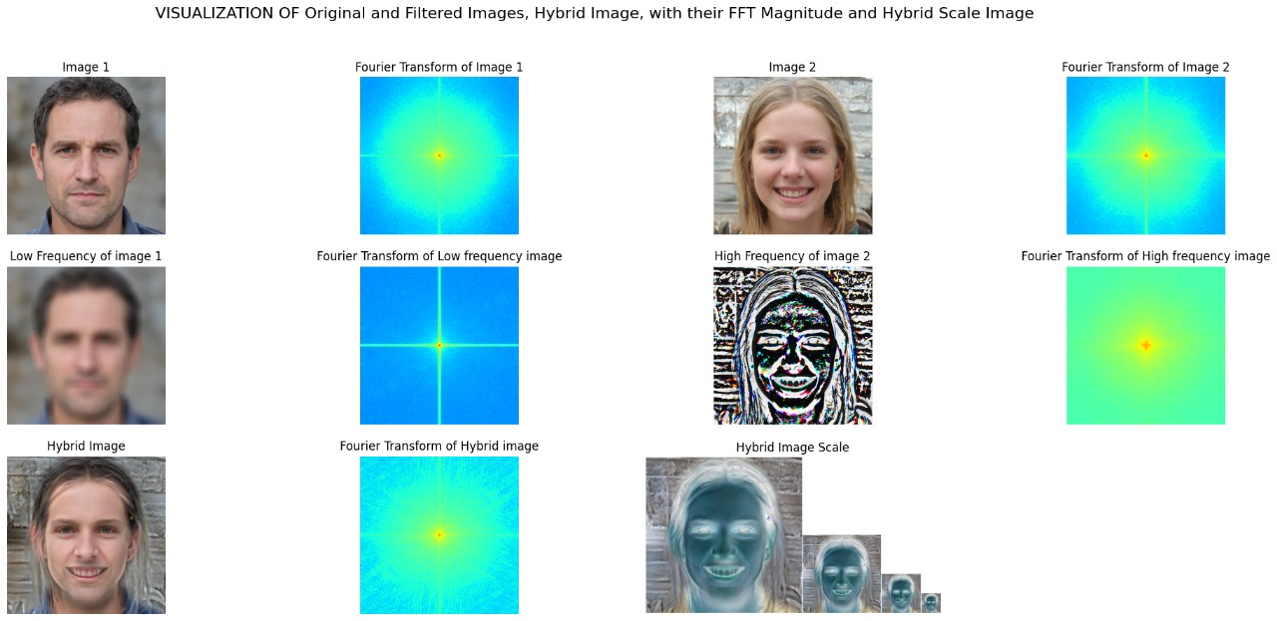
Average Filter

Slide 14
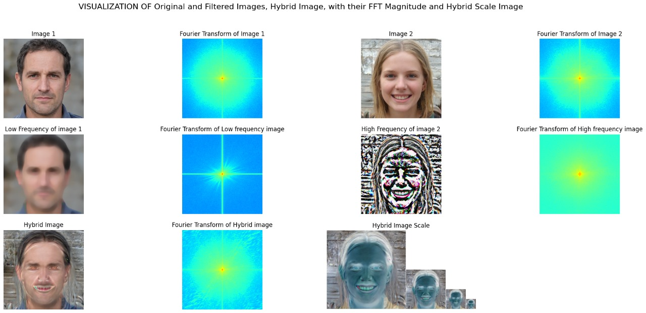
Median Filter

Slide 15
Discussion ctd…
We selected the best low pass filter using visual inspection.
The best filter was concluded as Gaussian and average filter.

Slide 16
Discussion
Visual Quality
The quality of the image had to be average.
If the image had too much details, output of the high-pass filter contained a significant amount of noise.
If the image was too soft/blurry the high-pass filter had very little detail

Slide 17
Discussion
Cutoff Frequency Impact
The cut-off frequency played a huge role in the final result
It acted as a critical factor in determining the threshold of which high and low pass filters cut off at.
The cutoff frequency was manually tuned to get the best results.

Slide 18
Discussion
Limitations
Any machine learning based algorithms were not leveraged to improve the final results.
The quality of the results were determined by visual inspection and manual tuning of the variables.

Slide 19
Conclusion
The application of Gaussian filters as both low-pass and high-pass filters in the creation of hybrid images demonstrates the effectiveness of this methodology in achieving desired visual effects.

Slide 20
References
[1] Oliva, A., Torralba, A., & Schyns, P. G. (2006). Hybrid images. ACM Transactions on Graphics (TOG), 25(3), 527-532. doi:10.1145/1141911.1141919
[2] https://www.kaggle.com/datasets/prasoonkottarathil/face-mask-lite-dataset

